Slide 1
Story Ending Generation with Incremental Encoding and Commonsense Knowledge
AAAI 2019
Jian Guan, Yansen Wang, Minlie Huang

Slide 2
Outline
Introduction
Motivation
Method
Experiment
Conclusion

Slide 3
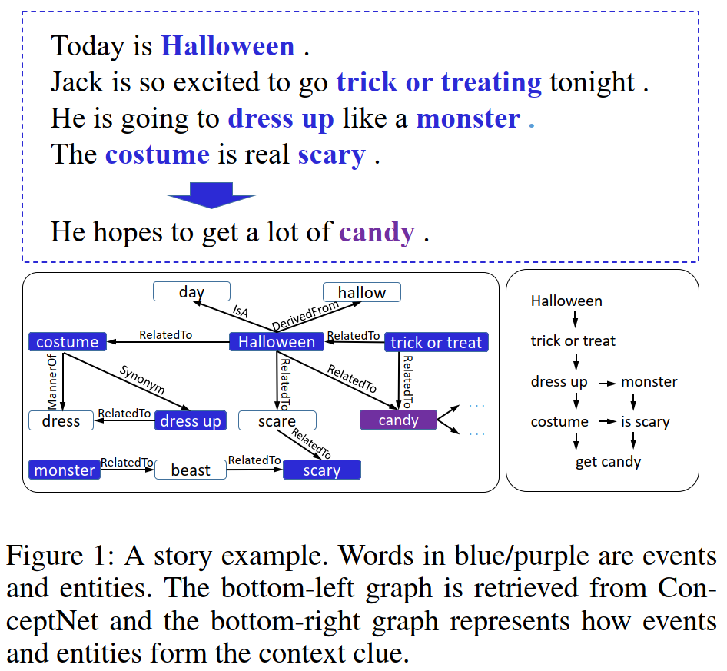
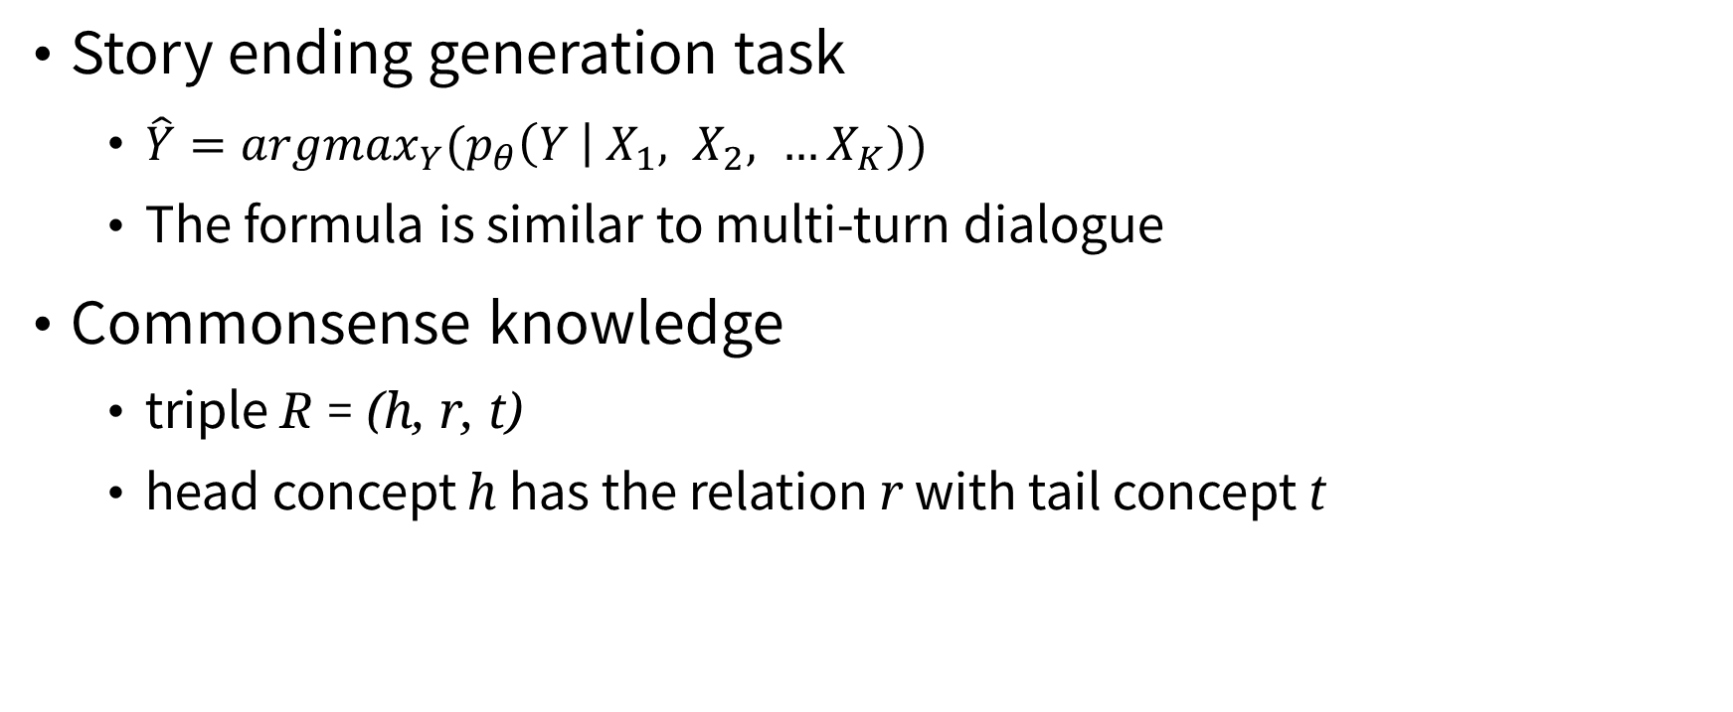
Introduction
Back to Outline
Story ending generation task
$\hat{Y}=argmax_{Y}(p_{θ}\left(Y \right| X_{1}, X_{2}, …X_{K}))$
The formula is similar to multi-turn dialogue
Commonsense knowledge
triple R = (h, r, t)
head concept h has the relation r with tail concept t

Slide 4
Motivation
Back to Outline
Deciding a reasonable ending not only depends on representing the context clues properly, but also on the ability of language understanding with implicit knowledge that is beyond the text surface.

Slide 5
Motivation
Back to Outline
No clue about “candy” In the context.
Halloween is related to “candy” in commonsense.
Generates ending about “candy” after incorporating commonsense knowledge into the model.

Slide 6
Method
Back to Outline
Incremental encoding (IE) scheme
Multi-source attention (MAS) mechanism
Supervision on the encoding network

Slide 7
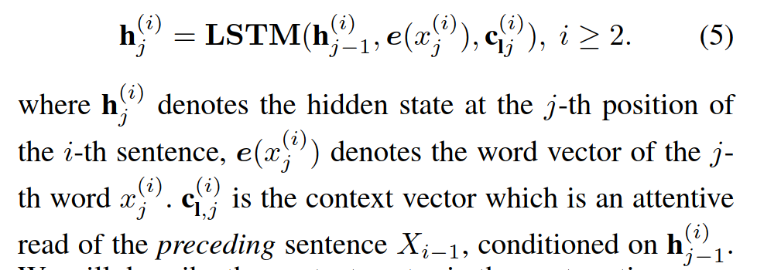
Method
Back to Outline
Incremental encoding (IE) scheme

Slide 8
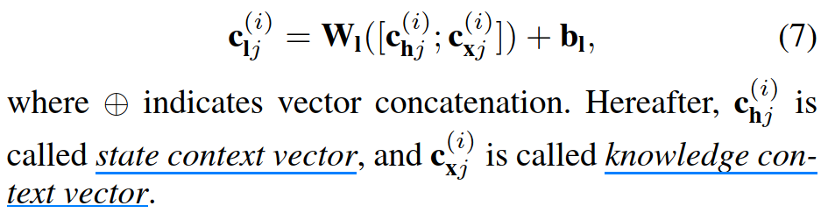
Method
Back to Outline
Multi-source attention (MSA) mechanism

Slide 9
Method
Back to Outline
Multi-source attention (MSA) mechanism
State context vector
Simple attention mechanism for seq2seq
Knowledge context vector
1) graph attention (Velickovic et al. 2018; Zhou et al. 2018)
2) contextual attention (Mihaylov and Frank 2018).
Velickovic, P.; Cucurull, G.; Casanova, A.; Romero, A.; Lio, P.; and Bengio, Y. 2018. Graph attention networks. In ICLR.
Zhou, H.; Yang, T.; Huang, M.; Zhao, H.; Xu, J.; and Zhu, X. 2018. Commonsense knowledge aware conversation generation with graph attention. In IJCAI.
Mihaylov, T., and Frank, A. 2018. Knowledgeable reader: Enhancing cloze-style reading comprehension with external commonsense knowledge. In ACL, 821–832.

Slide 10
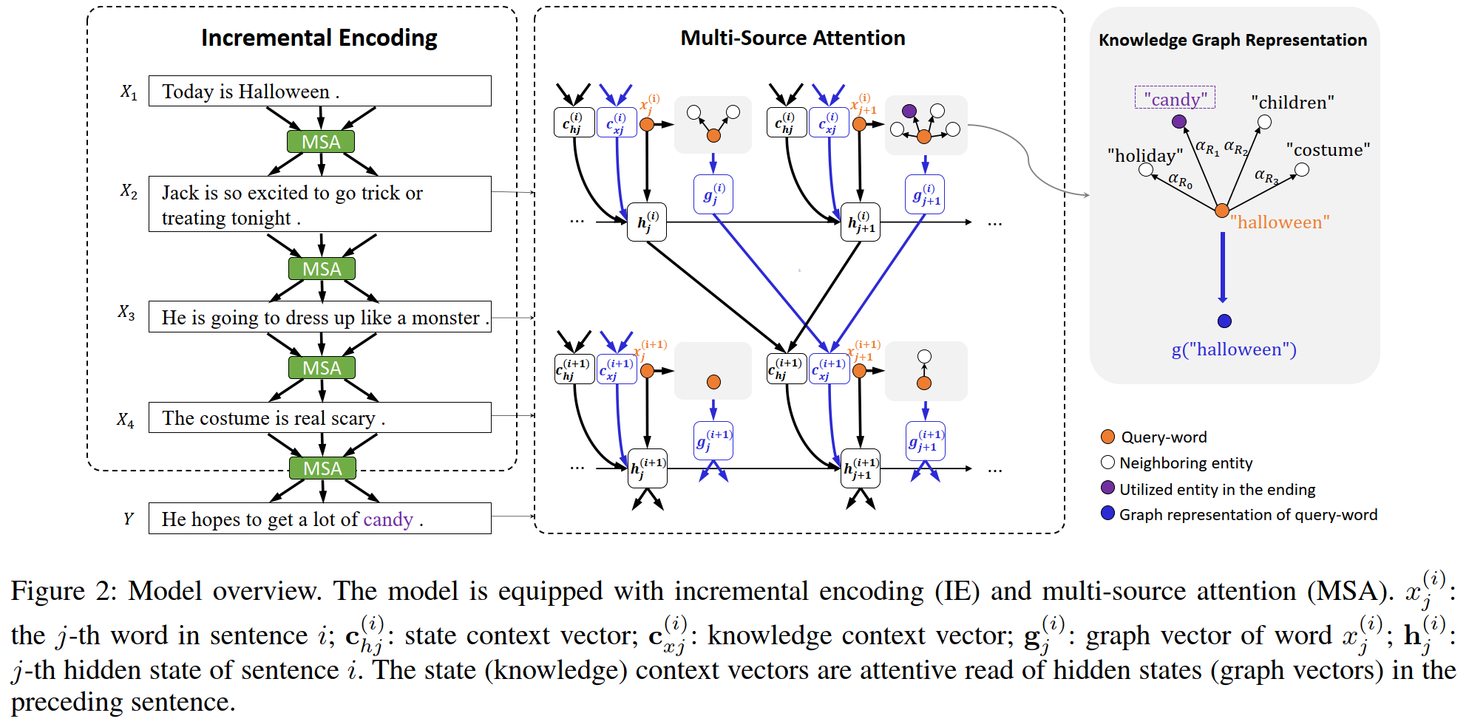
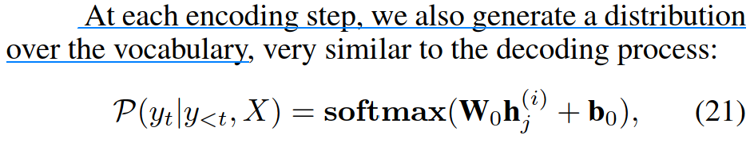
Method
Back to Outline

Slide 11
Method
Back to Outline
Supervision on the encoding network

Slide 12
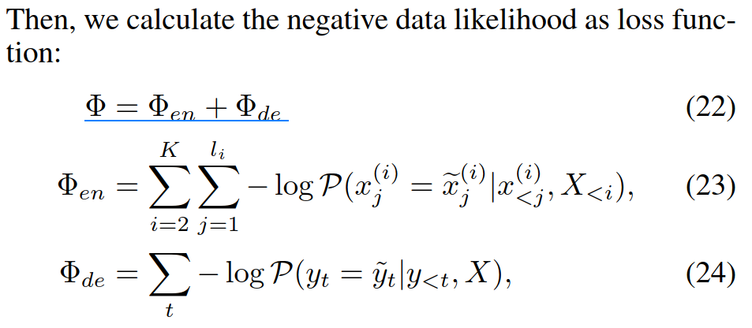
Method
Back to Outline

Slide 13
Experiment
Back to Outline
Dataset: ROCStories corpus
Automatic metric: PPL and BLEU
Human evaluation: grammar and logicality

Slide 14
Experiment
Back to Outline
Models
Baselines
Seq2seq
Hierarchical LSTM (HLSTM)
HLSTM + copy
HLSTM + MSA
This paper
IE
IE + MSA

Slide 15
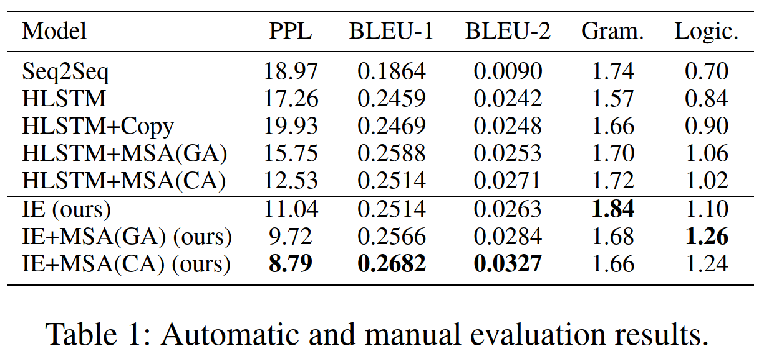
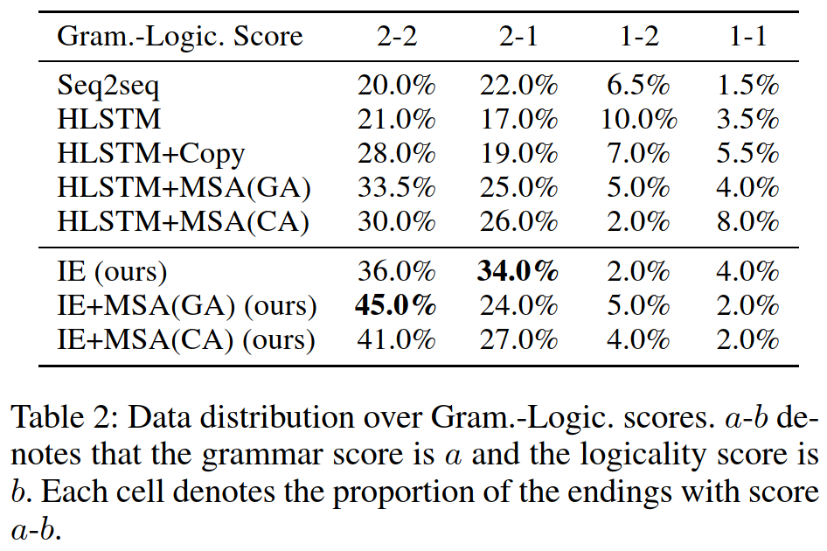
Experiment
Back to Outline

Slide 16
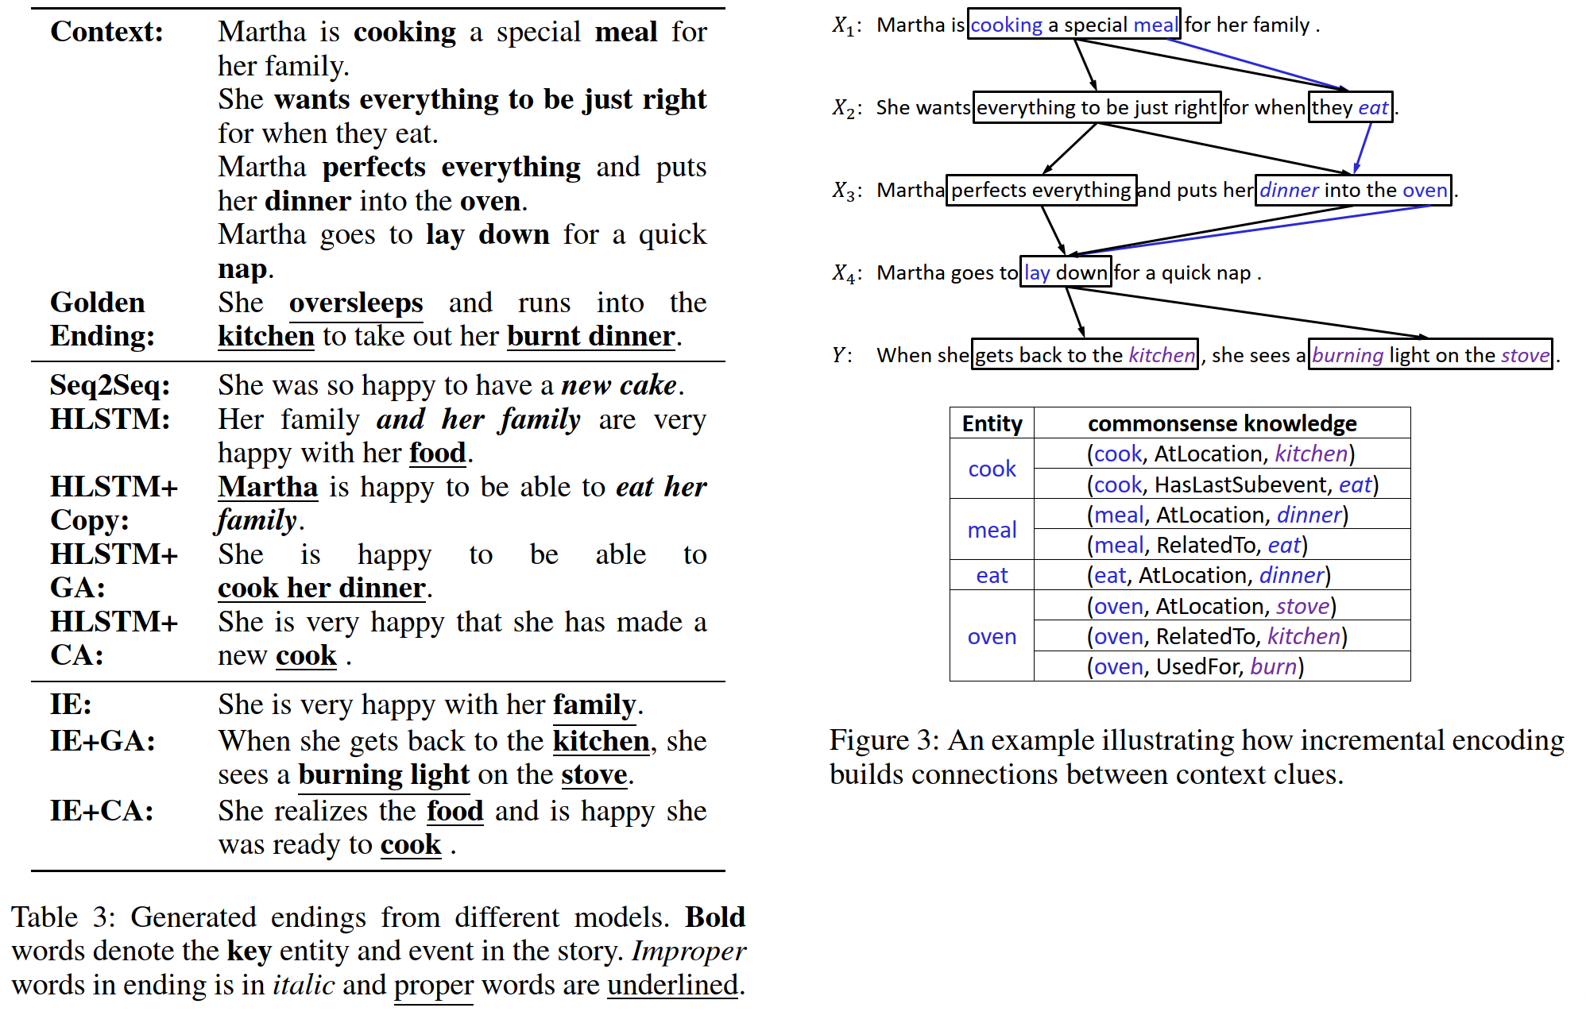
Experiment
Back to Outline

Slide 17
Conclusion
Back to Outline
Results:
For imposing supervision on the encoding network, the paper claims that "experiments show that it is better in logic than merely imposing supervision on the decoding network". But the paper does not present this experiment.
Multi-source attention leads to generate story endings that have more overlaps with the reference endings.
Incremental encoding (IE) is effective.
Using commonsense knowledge (IE + MSA) leads to significant improvements in logicality.
HLSTM equipped with MSA is better than those without MSA, indicating that commonsense knowledge is helpful.

